Slide 2
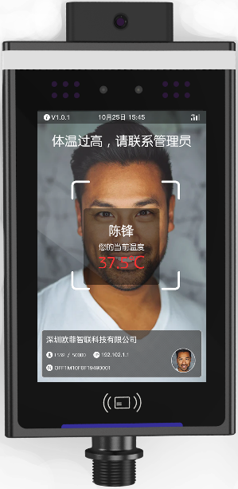
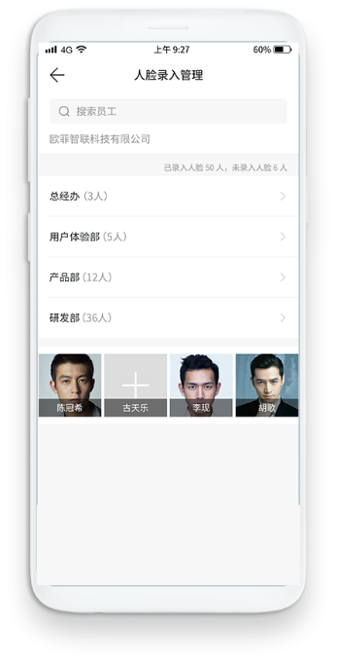
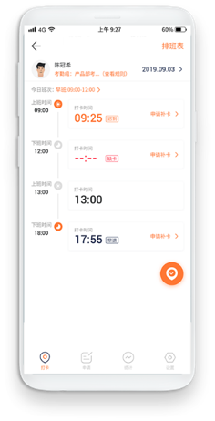
Real time on line solution
APP on line managed by administrator
Employee real-time veiew
Equipment works real time on line
Add person
Remove person
Remote to open the door
Manage personnel access
Check the person's entry, exit and temperature detected record.
Temperature detected record
Attendance record
Infrared measure temperature and warning
Face recognition and door opening
Visitors' record
Stranger snapshot and record

